Slide 1

Montgomery ARC (MARC)
The KV3B Experience

Slide 2

The KV3B Experience
Special Thanks To:
Dave KB3FRY & 2005 Field Day Crew
Tom K3TC - Jonathan N0YM - Others for Antennas
Set Up/Clean Up/Cooks & Crew
Steven AB3ST Photographer
Equipment Operators
Equipment Owners
MARC Members
MARC Guests
All photographs used with permission of AB3ST

Slide 3
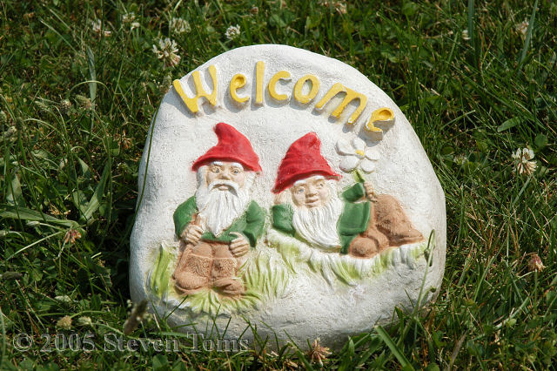
The KV3B Experience
        Field Day Friends
        “Welcome to the KV3B Experience”

Slide 4
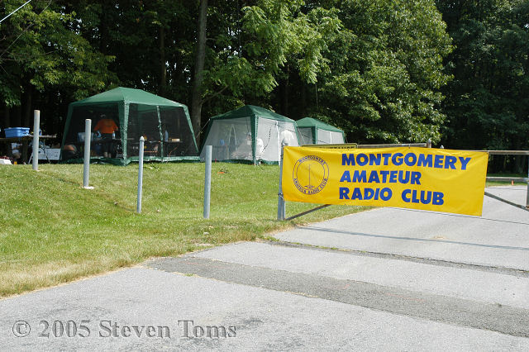
The KV3B Experience
Montgomery College - Germantown Campus
June 25 - 26 2005

Slide 5
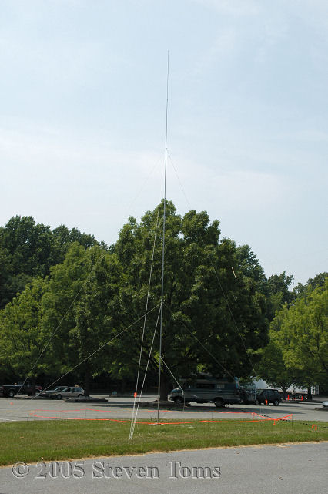
The KV3B Experience
Antennas Away!
On loan from
N0YM

Slide 6
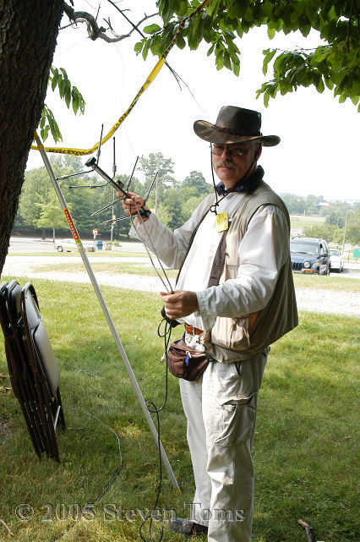
The KV3B Experience
Carl/WB3HAD
Setting Up

Slide 7
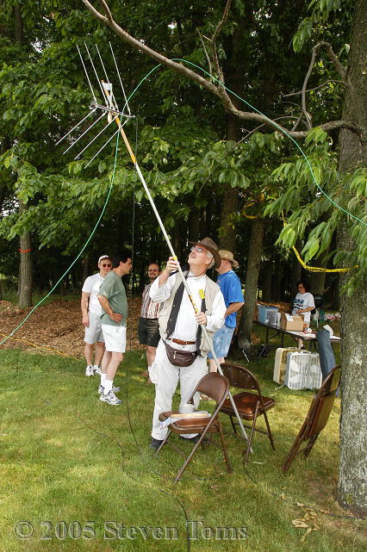
The KV3B Experience
Going up…
Carl/WB3HAD
Background:
Tom K3TC and
Others discuss
Their tactics

Slide 8
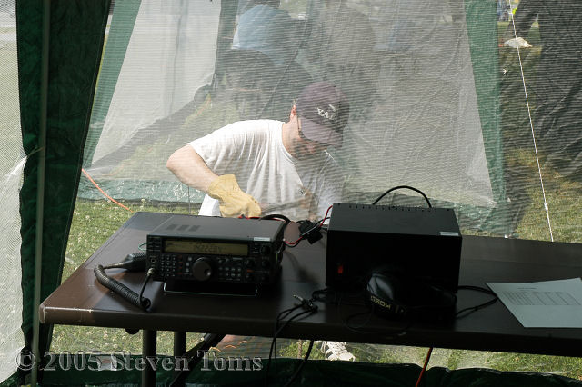
The KV3B Experience
N0YM Jonathan setting up the K3LNT (now N3CA – congratulations Michael!) Rig

Slide 9
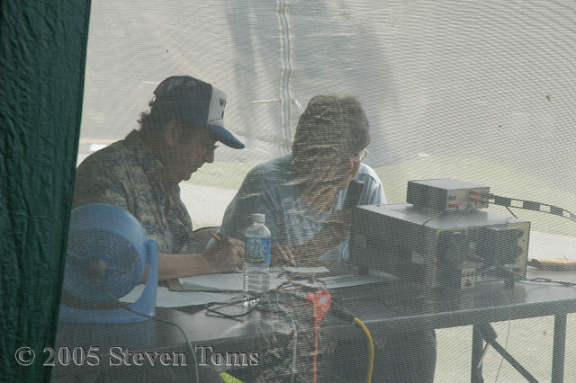
The KV3B Experience
Ron/W3GIS and Lynn KB3FRZ “lock and load”

Slide 10
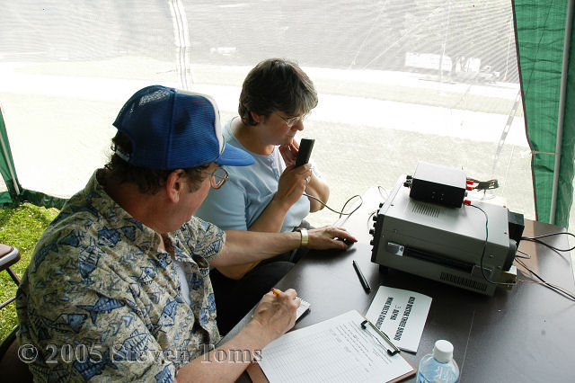
The KV3B Experience
Dude, Here’s How The Pro’s Do It …

Slide 11
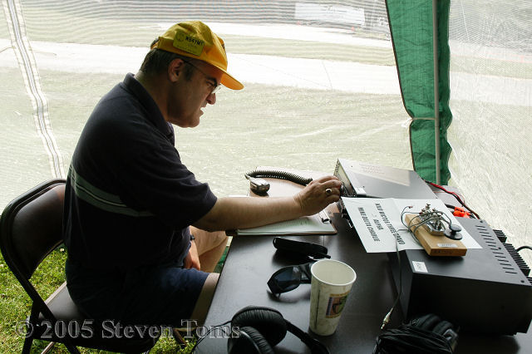
The KV3B Experience
John/WB4YMT – Search and Pounce Detail!

Slide 12
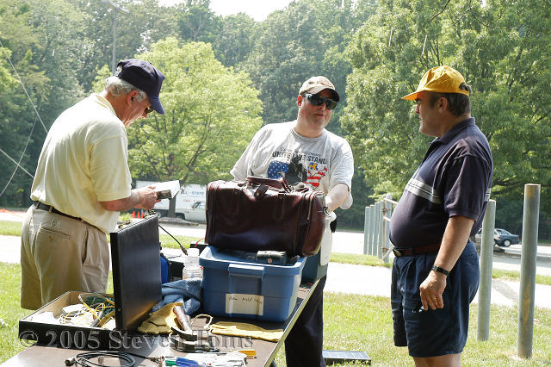
The KV3B Experience
WN3R Dick – Setting up Solar

Slide 13
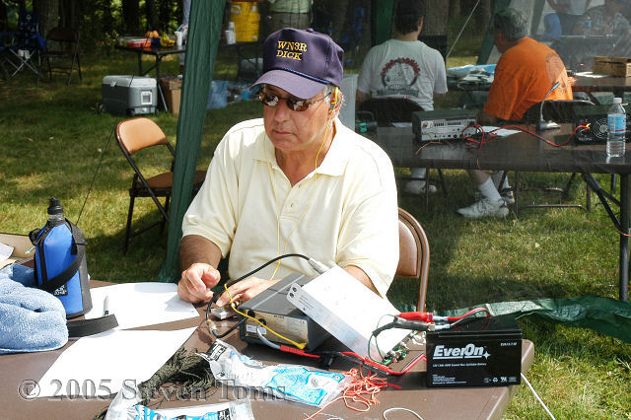
The KV3B Experience
WN3R Dick Smoking with Solar

Slide 14
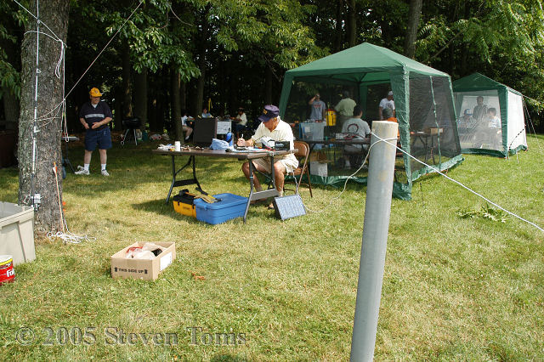
The KV3B Experience
Solar Powered CW Station

Slide 15
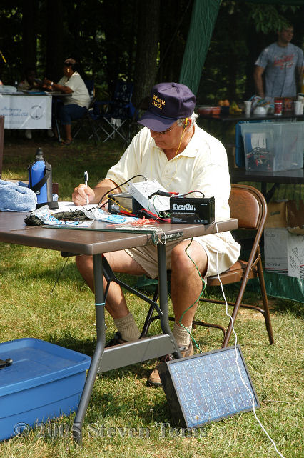
The KV3B Experience
WN3R Dick
Solar Power CW
Station

Slide 16
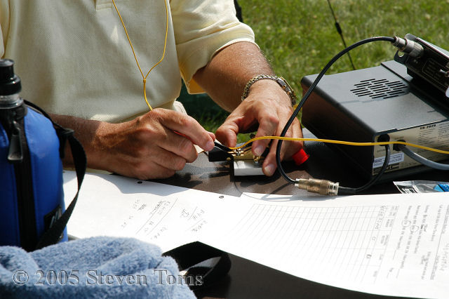
The KV3B Experience
Portable but Potent CW

Slide 17
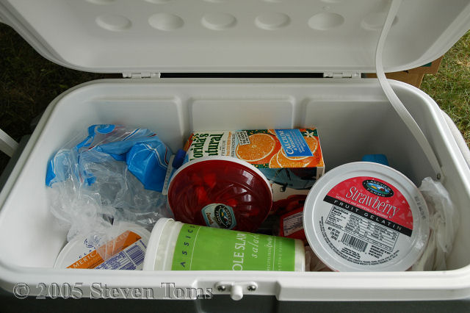
The KV3B Experience
Food Fight !

Slide 18
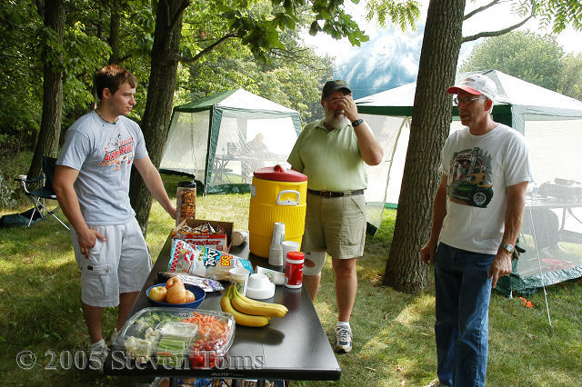
The KV3B Experience
The Usual “Field Day” Suspects
Bill (KB3ITA), Ed K3QX, and Mark (KA3OUD)

Slide 19
The Night Watch – KV3B
Field Day 2005

Slide 20
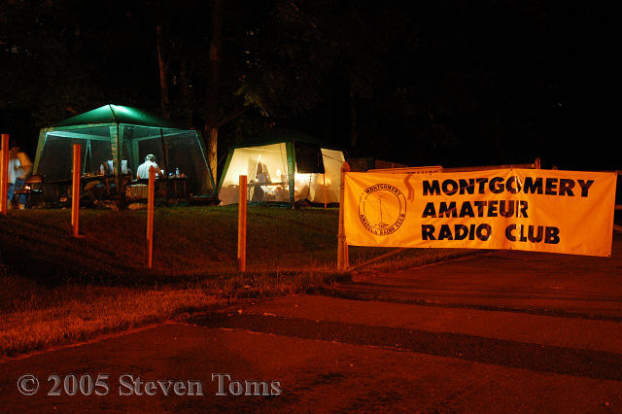
The KV3B Experience
Night Fall

Slide 21
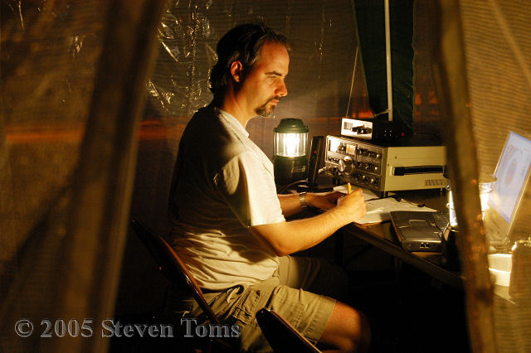
The KV3B Experience
N0YM Jonathan – Working the Mid-Watch

Slide 22
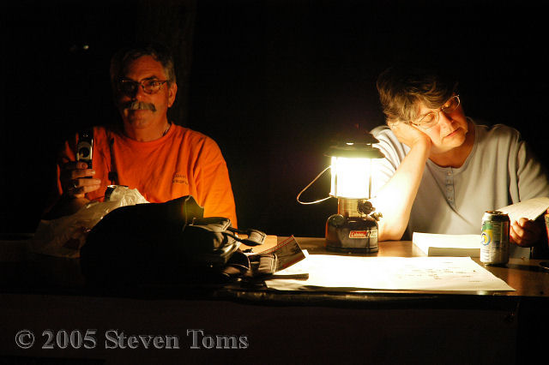
The KV3B Experience
The Dynamic Duo - KB3FRY Dave and KB3FRZ Lynn – “Sure Dave … Whatever”

Slide 23
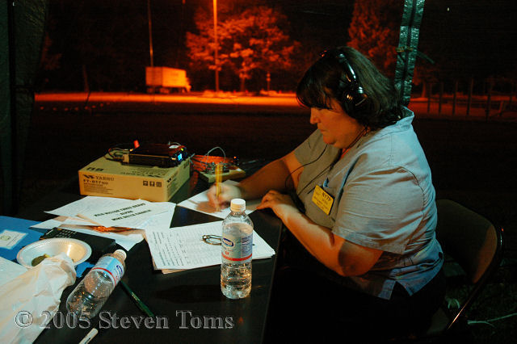
The KV3B Experience
NY7P Mona – QRP CW

Slide 24
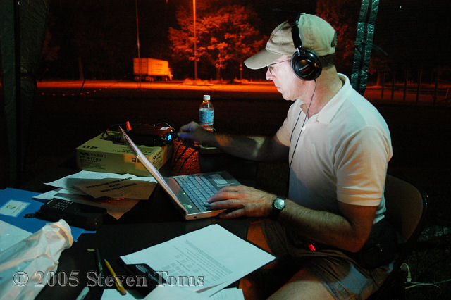
The KV3B Experience
K3CSX Fred Copies the ARRL Broadcast

Slide 25
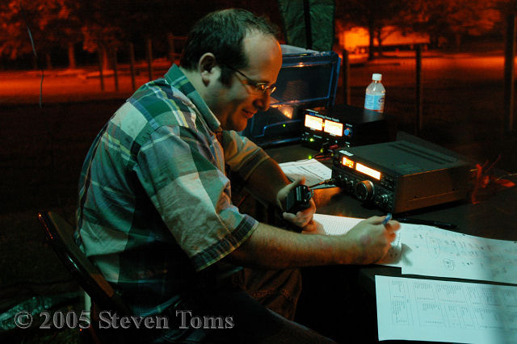
The KV3B Experience
Gotta Love These Night Shifts

Slide 26
The KV3B Experience
How’d things go this year?
MARC
- Better than doubled our contacts from last
year
- Offered a 1st time ever Scouting Radio Merit Badge Session on location
- Enjoyed higher participation from
members and guests
- Renewed our commitment to continuous
process improvement

